Slide 1


Microsoft® Office
Word 2007 Training
[Your company name] presents:
Get up to speed

Slide 2
Course contents
Overview: Have you heard the word?
Lesson 1: Get to know the Ribbon
Lesson 2: Find everyday commands
Lesson 3: A new file format
Each lesson includes a list of suggested tasks and a set of test questions.

Slide 3
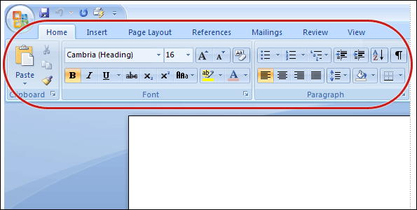
Overview: Have you heard the word?
Word 2007 is here! And while it may look a little unfamiliar, it’s designed to be even easier and better than the version you’re used to—including new design elements and a new file format.

Slide 4
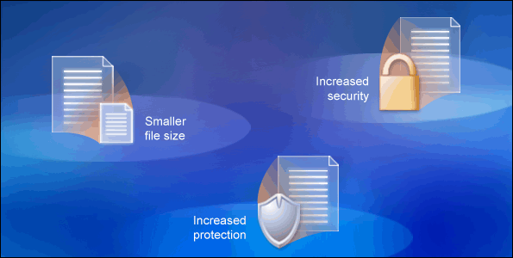
Overview: Have you heard the word?
So let’s get up to speed and learn the best ways to use the new Ribbon, get a handle on finding popular commands, and understand what the new file format will do for you.

Slide 5
Course goals
Work with the Ribbon—the new feature that makes Word easier to use than ever before.
Find everyday, common commands you need to do your job.
Use the new Word file format in the way that’s best for you.

Slide 6
Lesson 1
Get to know the Ribbon

Slide 7
Get to know the Ribbon
The new Ribbon spans the top of the Word program window.
When you first open Word 2007, you may be surprised by its new look. Most of the changes are in the Ribbon, the area that spans the top of the Word program window. It brings the most popular commands to the forefront.

Slide 8
Get to know the Ribbon
The new Ribbon spans the top of the Word program window.
Why the change? To make your work easier and faster. The Ribbon was thoroughly researched and designed from users’ experiences so that commands are in the optimal position.

Slide 9
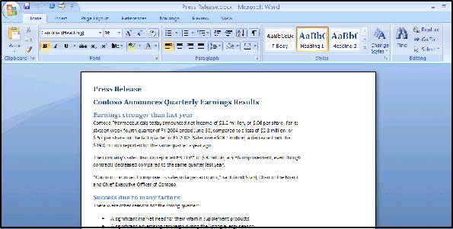
The Ribbon in action
Animation: Right-click, and click Play.
Use the Ribbon for common actions.
The Ribbon’s ease of use and convenience are best understood when seen in action. In the animation, commands on the Home tab are used to cut and paste text; the text format is changed by using a Style; and finally, the page background color is altered on the Page Layout tab.

Slide 10
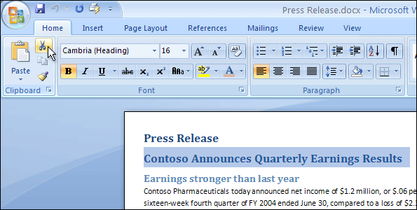
The Ribbon in action
Use the Ribbon for common actions.
The Ribbon is easy to use and convenient, with commonly used commands shown in one place. For example, you can cut and paste text by using commands on the Home tab; change text formatting by using a Style; and alter the page background color on the Page Layout tab.

Slide 11
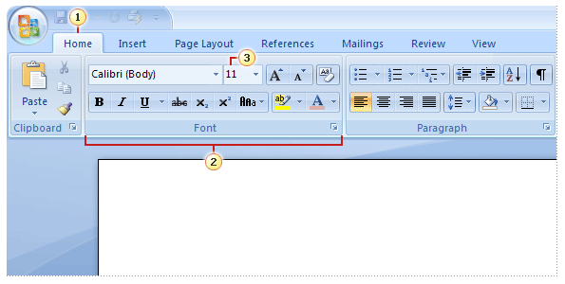
What’s on the Ribbon?
Tabs
Groups
Commands
There are three basic components to the Ribbon: tabs, groups, and commands.

Slide 12
What’s on the Ribbon?
Tabs
Groups
Commands
Everything on a tab has been carefully selected according to user activities. For example, the Home tab contains all the things you use most often, such as the commands in the Font group for changing text font.

Slide 13
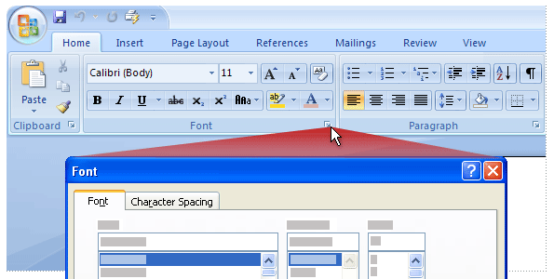
More commands with Dialog Box Launchers
Click the Dialog Box Launcher to see more options for a particular group.
At first glance, you may not see a certain command from a previous version of Word. Fret not. Some groups have a small diagonal arrow in the lower-right corner .

Slide 14
More commands with Dialog Box Launchers
Click the Dialog Box Launcher to see more options for that particular group.
The arrow is called a Dialog Box Launcher. When you click it, you’ll see more options related to that group. Those options often appear in the form of a dialog box or a task pane that you’ll recognize from a previous version of Word.

Slide 15
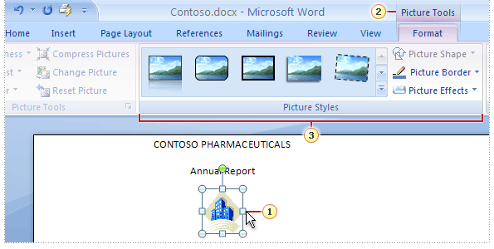
Additional tools appear
The Picture Tools are groups of commands for working with pictures.
In Word 2007, certain tools appear only when you need them. For example, let’s say you’ve inserted a picture. But now you want to do more with it, like cropping it or changing how text wraps around it. Where are those commands now?

Slide 16
Additional tools appear
The Picture Tools are groups of commands for working with pictures.
Here’s how to find them:
Select the picture.
The Picture Tools appear.

Slide 17
Additional tools appear
The Picture Tools are groups of commands for working with pictures.
Here’s how to find them:
Additional groups and commands appear for working with pictures, like the Picture Styles group.

Slide 18
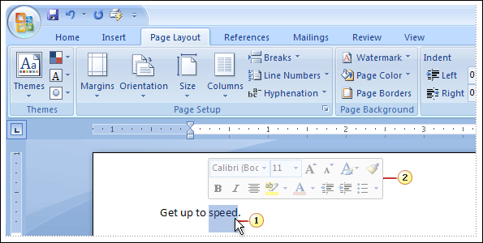
The Mini toolbar
Use the Mini toolbar to quickly format text.
Some formatting commands are so useful that you want to have them available whatever you’re doing. Let’s say you want to quickly format some text, but you’re working on the Page Layout tab.

Slide 19
The Mini toolbar
Use the Mini toolbar to quickly format text.
You could click the Home tab to see the formatting options, but there’s a faster way:
Select your text by dragging with your mouse, and then point at the selection.

Slide 20
The Mini toolbar
Use the Mini toolbar to quickly format text.
You could click the Home tab to see the formatting options, but there’s a faster way:
The Mini toolbar appears in a faded fashion. Point to it, and it becomes solid so you can click a formatting option.

Slide 21
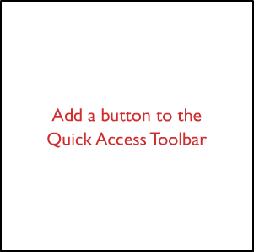
The Quick Access Toolbar
The Quick Access Toolbar is the small area to the upper left of the Ribbon. It contains the things that you use over and over every day: Save, Undo, Redo, and Print.
You can add your favorite commands to the Quick Access Toolbar so that they’re available no matter which tab you’re on. The animation shows how to add buttons to the toolbar and then remove them.
Animation: Right-click, and click Play.
Adding a button to the Quick Access Toolbar

Slide 22
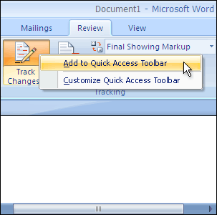
The Quick Access Toolbar
The Quick Access Toolbar is the small area to the upper left of the Ribbon. It contains the things that you use over and over every day: Save, Undo, Redo, and Print.
You can add your favorite commands to the Quick Access Toolbar so that they’re available no matter which tab you’re on. You can also remove them.
Adding a button to the Quick Access Toolbar

Slide 23
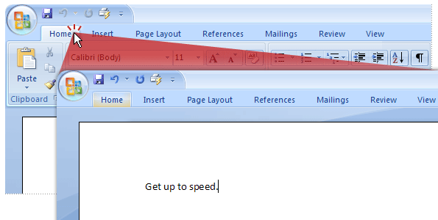
Temporarily hide the Ribbon
For more room, double-click the name of the active tab to hide the groups.
The Ribbon makes everything in Word 2007 nicely centralized and easy to find. But sometimes you don’t need to find things. You just want to work on your document, and you’d like more space to do that.

Slide 24
Temporarily hide the Ribbon
For more room, double-click the name of the active tab to hide the groups.
It’s as easy to temporarily hide the Ribbon as it is to use it. Just double-click the name of the active tab. The groups disappear so that you have more room.

Slide 25
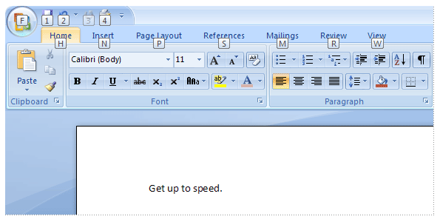
Use the keyboard
Press ALT to display Key Tip badges for the Ribbon tabs, Microsoft Office Button, and Quick Access Toolbar.
Okay, keyboard people, this information is for you. Shortcuts that start with the CTRL key remain the same as in previous versions of Word. But the Ribbon design also comes with new shortcuts.

Slide 26
Use the keyboard
Press ALT to display Key Tip badges for the Ribbon tabs, Microsoft Office Button, and Quick Access Toolbar.
This brings two big advantages over previous versions:
Shortcuts for every single button on the Ribbon.
Shortcuts that often require fewer keys.

Slide 27
Use the keyboard
Press ALT to display Key Tip badges for the Ribbon tabs, Microsoft Office Button, and Quick Access Toolbar.
The new shortcuts also have a new name: Key Tips. Press ALT to make the Key Tip badges appear for all Ribbon tabs, the Quick Access Toolbar commands, and the Microsoft Office Button.

Slide 28
Use the keyboard
Press ALT to display Key Tip badges for the Ribbon tabs, Microsoft Office Button, and Quick Access Toolbar.
Next, press the Key Tip for the tab you want to display; for example, press H for the Home tab. This makes all the Key Tips for that tab’s commands appear. Then press the Key Tip for the command you want.

Slide 29
Suggestions for practice
Use the Ribbon.
Make additional tabs appear.
Work with the Mini toolbar.
Use the Quick Access Toolbar.
Hide groups and commands.
Use keyboard shortcuts.
Online practice (requires Word 2007, part of the 2007 Microsoft Office system, beta 2 version)

Slide 30
Test 1, question 1
Where is the Quick Access Toolbar, and when should you use it? (Pick one answer.)
In the upper-left corner of the screen. Use it for your favorite commands.
It floats above your text. Use it when you need to make formatting changes.
In the upper-left corner of the screen. Use it when you need to quickly access a document.
On the Home tab. Use it when you need to quickly launch or start a new document.

Slide 31
Test 1, question 1: Answer
In the upper-left corner of the screen. Use it for your favorite commands.
It’s the small toolbar with the Save, Undo, Redo, and Print buttons. You can add your favorite commands by right-clicking a command and choosing Add to Quick Access Toolbar.

Slide 32
Test 1, question 2
The Mini toolbar appears if you do which of the following? (Pick one answer.)
Double-click the name of the active tab on the Ribbon.
Select text.
Select text and then point at it.
Any of the above.

Slide 33
Test 1, question 2: Answer
Select text and then point at it.
If will also appear if you right-click your selected text.

Slide 34
Test 1, question 3
If you click this button in Word 2007, what happens? (Pick one answer.)
You temporarily hide the Ribbon so that you have more room for your document.
You apply a bigger font size to your text.
You see additional options.
You add a command to the Quick Access Toolbar.

Slide 35
Test 1, question 3: Answer
You see additional options.
Often a dialog box will appear, and it may look familiar from previous versions of Word.

Slide 36
Lesson 2
Find everyday commands

Slide 37

Find everyday commands
Now it’s time to get things done.
It’s exciting that Word 2007 is new, but you have things to do. Now it’s time to point out the exact locations of the most commonly used commands, which are right where you need them in the new design.

Slide 38
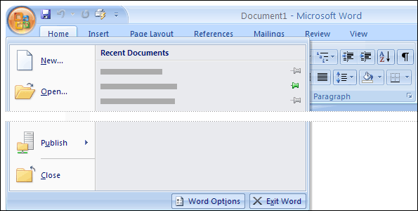
Start with the Microsoft Office Button
What happened to the File menu? Click the Microsoft Office Button to find out.
The place to start a Word document is the Microsoft Office Button, shown here in the upper-left corner of the window. Click the button, and a menu appears that looks similar to the File menus in previous versions of Word.

Slide 39
Start with the Microsoft Office Button
What happened to the File menu? Press the Microsoft Office Button to find out.
On the left of the menu are all the commands to work with a file. Here’s where to create a new document or open an existing one.

Slide 40
Start with the Microsoft Office Button
What happened to the File menu? Click the Microsoft Office Button to find out.
The right side of the menu lists your recently opened documents. These are always conveniently visible so that you don’t have to search your computer for a document you frequently work on.

Slide 41
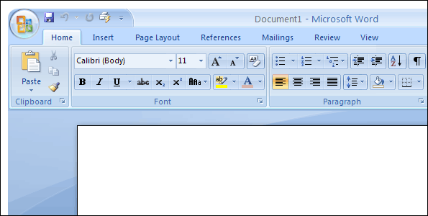
Bullets, numbers, and more
Don’t overlook the Paragraph group on the Home tab.
Once you have a document open and have typed your text, you’ll no doubt want to format that text. Many familiar formatting commands are in view on the Home tab, in the Font group.

Slide 42
Bullets, numbers, and more
Don’t overlook the Paragraph group on the Home tab.
In the Paragraph group you have the ever-popular bulleted lists, numbered lists, and multilevel lists. You’ve got your indentation and alignment commands here as well.

Slide 43
Bullets, numbers, and more
Don’t overlook the Paragraph group on the Home tab.
Remember to click that small diagonal arrow in the lower-right corner of the group, the Dialog Box Launcher, if you don’t see options that you are accustomed to using in Word.

Slide 44
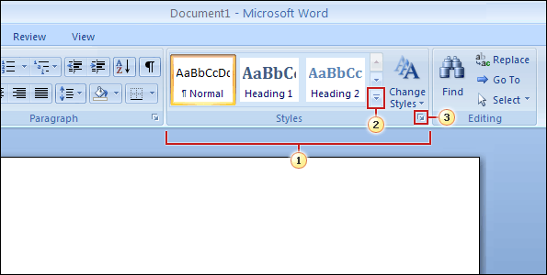
What about styles?
Choose a ready-made quick style, or apply the styles you’ve made before.
If you’re interested in a more powerful and efficient approach to formatting than just the bold and italic commands, you’ll want to know about styles in the new Word.

Slide 45
What about styles?
Choose a ready-made quick style, or apply the styles you’ve made before.
You work with styles on the Home tab, in the Styles group:
Quick styles are ready-made, professional styles that are quick and easy to apply; they have a new look with this version.

Slide 46
What about styles?
Choose a ready-made quick style, or apply the styles you’ve made before.
You work with styles on the Home tab, in the Styles group:
Click the More button to see several more ready-to-use Quick Styles.

Slide 47
What about styles?
Choose a ready-made quick style, or apply the styles you’ve made before.
You work with styles on the Home tab, in the Styles group:
Click the Dialog Box Launcher to open the Styles pane.

Slide 48
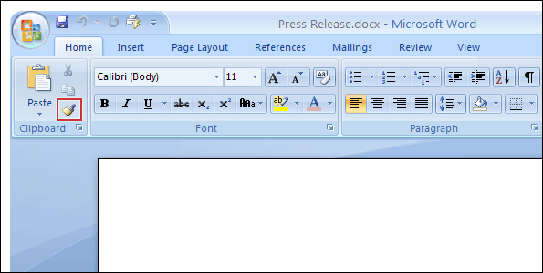
The Format Painter
The Format Painter is located on the Home tab, in the Clipboard group.
Another high-speed formatting command is Format Painter. It’s on the very left of the Home tab, in the Clipboard group.

Slide 49
The Format Painter
The Format Painter is located on the Home tab, in the Clipboard group.
To use the Format Painter, place the cursor in the text whose format you want to copy, and then click the Format Painter button. Then select the text that you want to paint on the new format.

Slide 50
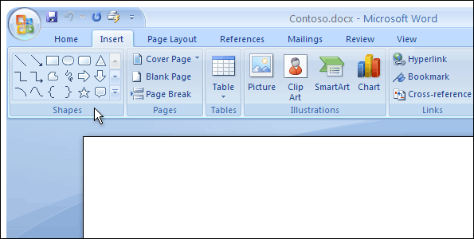
Insert pictures, hyperlinks, headers, and footers
The Insert tab offers your document a wealth of added information.
To give your text power and punch, you may want pictures, clip art, charts, or shapes in your document. The place to add these is the Insert tab.

Slide 51
Insert pictures, hyperlinks, headers, and footers
The Insert tab offers your document a wealth of added information.
But those aren’t the only commands on this tab. You’ve got Tables and Hyperlink here, as well.

Slide 52
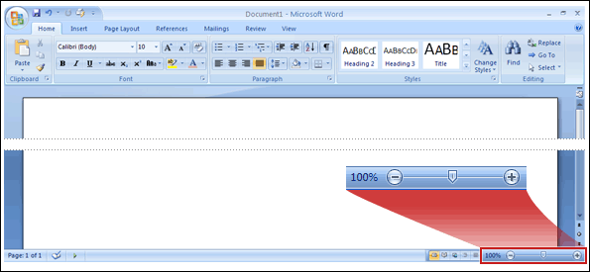
Zoom
Look in the lower-right corner if you need to zoom.
After you insert something, you may need a closer look at its details. So you’ll definitely want to know where you zoom.

Slide 53
Zoom
Look in the lower-right corner if you need to zoom.
Look in the lower-right corner. Drag the slider to the right to zoom in, and drag it to the left to zoom out.

Slide 54
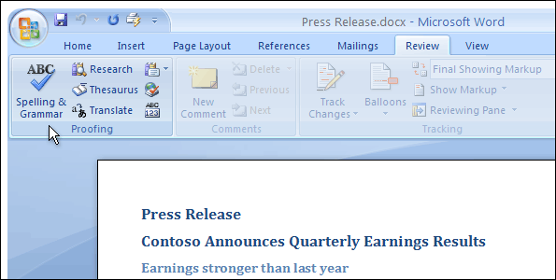
Check your spelling and grammar
Make no mistake: Don’t forget the spelling and grammar check.
When you’ve done most of the work on your document, you’ll want to check the spelling and the grammar before you print it or send it in e-mail.

Slide 55
Check your spelling and grammar
Make no mistake: Don’t forget the spelling and grammar check.
The Spelling & Grammar command is on the Review tab, because this is part of reviewing your work. Look toward the far left, in the Proofing group.

Slide 56
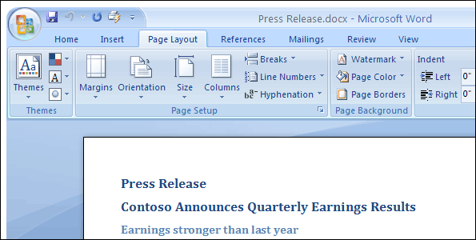
Ready to print?
Before you print, check your page layout and page setup.
Before you print, it’s smart to check how your pages are laid out for the printer. Everything you need is on the Page Layout tab.

Slide 57
Ready to print?
Before you print, check your page layout and page setup.
The Page Setup group contains commands for setting Size, Orientation (landscape and portrait), Margins, and other options.

Slide 58
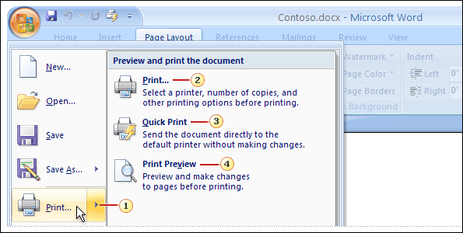
Yes, ready to print
Choose one of several printing commands by clicking the Microsoft Office Button.
When you are truly ready to print, go back to the Microsoft Office Button. But keep in mind that now you’ve got options.

Slide 59
Yes, ready to print
Choose one of several printing commands by clicking the Microsoft Office Button.
As the picture shows:
If you click the Print command, you’ll get the Print dialog box. But point at the arrow on the right of the Print command instead, and you’ll see three commands.

Slide 60
Yes, ready to print
Choose one of several printing commands by clicking the Microsoft Office Button.
As the picture shows:
The Print command opens the familiar Print dialog box.
The Quick Print command sends your document immediately to the printer.

Slide 61
Yes, ready to print
Choose one of several printing commands by clicking the Microsoft Office Button.
As the picture shows:
The Print Preview command shows you how the printed document will look. If you use this command a lot, you might like to add it to the Quick Access Toolbar.

Slide 62
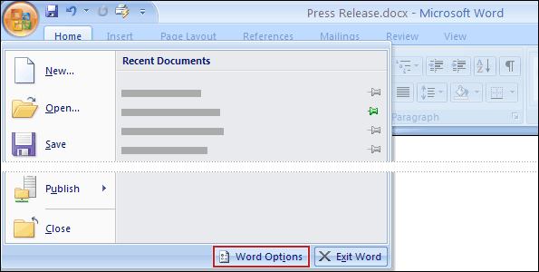
Behind the scenes
Program options are no longer available from the Tools menu. Instead, click the Microsoft Office Button.
The features you’re accustomed to using every day are on the Ribbon, and much easier to find than before. But where are the behind-the-scenes settings that are all about controlling how Word works, not producing documents?

Slide 63
Behind the scenes
Program options are no longer available from the Tools menu. Instead, click the Microsoft Office Button.
In previous versions of Word, you clicked Options on the Tools menu. Now you work with all these settings by clicking Word Options at the bottom of the Microsoft Office Button menu.

Slide 64
Suggestions for practice
Add a bulleted list.
Apply Quick Styles.
Zoom out to see all text.
Change the Quick Style set.
Use the Format Painter.
Online practice (requires Word 2007, part of the 2007 Microsoft Office system, beta 2 version)

Slide 65
Test 2, question 1
You can apply bulleted lists using which tab and which group? (Pick one answer.)
The Page Layout tab, Paragraph group.
The Home tab, Paragraph group.
The Insert tab, Symbols group.
The Insert tab, Text group.

Slide 66
Test 2, question 1: Answer
The Home tab, Paragraph group.
This is where you can apply bulleted lists. Tip: You can also apply bulleted lists by using the Mini toolbar.

Slide 67
Test 2, question 2
How do you choose print options in the new version of Word? (Pick one answer.)
Click the Print button on the Ribbon.
Click the Print button on the Quick Access Toolbar.
Use the Microsoft Office Button.
Either 1 or 2.

Slide 68
Test 2, question 2: Answer
Use the Microsoft Office Button.
You use the Microsoft Office Button to find the print commands. This is where you open print preview as well.

Slide 69
Test 2, question 3
In which corner of the Word program window will you find zoom control? (Pick one answer.)
Upper-right.
Upper-left.
Lower-left.
Lower-right.

Slide 70
Test 2, question 3: Answer
Lower-right.
In the lower-right corner is the control you use to zoom in and out. You can also use the View menu to see the zoom controls.

Slide 71
Lesson 3
A new file format

Slide 72

A new file format
There’s a new file format for Word 2007.
One more big change in the new version of Word: an improved file format. What does that mean to you?

Slide 73
A new file format
There’s a new file format for Word 2007.
The new file format helps keep your file sizes smaller and safer, along with other advantages. In this lesson you’ll also learn what happens when you open files that don’t have the new format.

Slide 74
Why the change? XML
Good reasons for the new Word file format
The new Word document file format is based on the new Microsoft Office Open XML Formats. Don’t worry, you don’t have to understand XML; it’s all behind the scenes.

Slide 75
Why the change? XML
Good reasons for the new Word file format
Just keep in mind that the new XML-based format helps to make:
Safer documents, by separating files that contain scripts or macros.

Slide 76
Why the change? XML
Good reasons for the new Word file format
Just keep in mind that the new XML-based format helps to make:
Smaller file sizes.
Documents that are less susceptible to damage.

Slide 77
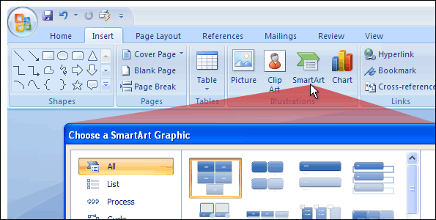
Why the change? New features
The new file format gives you new features, like SmartArt graphics.
The new file format also gives you the ability to use features that are available only in Word 2007. One of these features is the new SmartArt™ graphics.

Slide 78
Why the change? New features
The new file format gives you new features, like SmartArt graphics.
The illustration shows you how to start such a graphic in Word. Notice how many SmartArt graphic designs are available to choose from.

Slide 79
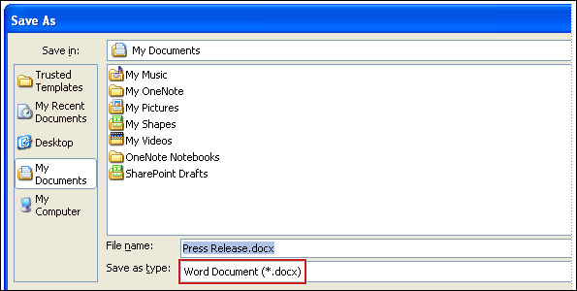
How do I know I’m using the new format?
If it says Word Document in the Save as type box, then you’re using the new file format.
When you create a new document in Word 2007, and then save the document, the new file format will automatically be chosen for you.

Slide 80
How do I know I’m using the new format?
If it says Word Document in the Save as type box, then you’re using the new file format.
You can make sure of the format by looking closely at the Save As dialog box. For example, notice in the picture that the Save as type box says Word Document (.docx)? This means that a new Word 2007 file format is being used.

Slide 81
There’s more than one file format?
File extension | What it’s used for
.docx | Standard Word document, no macros or code
.dotx | Word template, no macros or code
.docm | Word document that could contain macros or code
.dotm | Word template that could contain macros or code
Word 2007 file formats
The only outward difference you are likely to see with new Word file formats is if you use macros or code.

Slide 82
There’s more than one file format?
File extension | What it’s used for
.docx | Standard Word document, no macros or code
.dotx | Word template, no macros or code
.docm | Word document that could contain macros or code
.dotm | Word template that could contain macros or code
Word 2007 file formats
Previously, there were just two types of Word file types: documents and templates (.doc and .dot). With Word 2007 there are four file types: .docx, .dotx, .docm, and .dotm.

Slide 83
There’s more than one file format?
File extension | What it’s used for
.docx | Standard Word document, no macros or code
.dotx | Word template, no macros or code
.docm | Word document that could contain macros or code
.dotm | Word template that could contain macros or code
Word 2007 file formats
Basic documents and templates (.docx and .dotx) can no longer contain macros or code, which is how they are made safer for everyday use: No one can slip hidden code into a document.

Slide 84
There’s more than one file format?
File extension | What it’s used for
.docx | Standard Word document, no macros or code
.dotx | Word template, no macros or code
.docm | Word document that could contain macros or code
.dotm | Word template that could contain macros or code
Word 2007 file formats
But because macros are useful things to have, there are two additional file types to support documents and templates which contain code: .docm and .dotm.

Slide 85
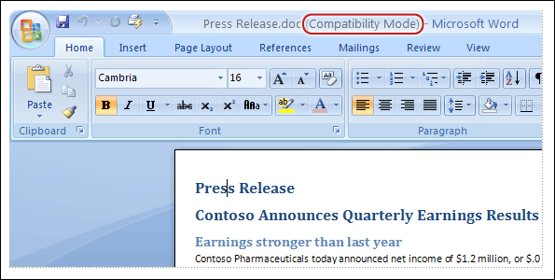
What about the documents I already have?
How you know when Word has opened a document in compatibility mode
You’re probably wondering, “What happens when I open my older documents in the new version of Word?” Well, Word 2007 can open files created in all previous versions of Word, 1.0 through 2003.

Slide 86
What about the documents I already have?
How you know when Word has opened a document in compatibility mode
Word will open older documents in compatibility mode. You know this because at the top of the document, (Compatibility Mode) appears next to the name of the file.

Slide 87
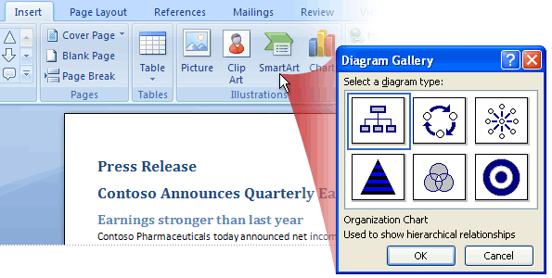
Compatibility mode
In compatibility mode, this diagram dialog box doesn’t have as many choices.
With compatibility mode, Word is telling you that the document uses an older file format. That file format doesn’t understand some of the Word 2007 features, so they’re either turned off or modified so that they approximate an older version of Word.

Slide 88
Compatibility mode
In compatibility mode, this diagram dialog box doesn’t have as many choices.
Here, a Word 2003 document was opened in Word 2007. Notice that the title bar includes (Compatibility Mode). And the Choose a SmartArt Graphic dialog box doesn’t appear at all—the Diagram Gallery appears instead.

Slide 89
Compatibility mode
In compatibility mode, this diagram dialog box doesn’t have as many choices.
It’s a good idea to stay in compatibility mode if you know you’ll be sharing your documents with a lot of people who are using older versions of Word. That way, what you see is what they see.

Slide 90
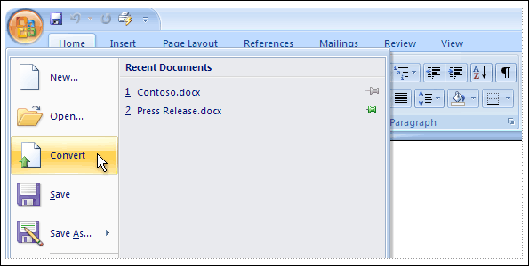
Converting your old files
How to convert your files to the new format
Naturally, you can convert an older document to the new file format. With the document open in Word 2007, just click the Microsoft Office Button, and then click the Convert command on the menu.

Slide 91
Converting your old files
How to convert your files to the new format
This conversion gives you the benefits of the new format (helps make files smaller, more secure, and so on) as well as the new features in their full, undiminished fashion.

Slide 92
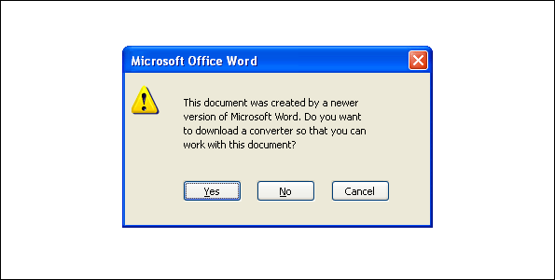
Share documents by using a converter
When someone tries to open a document from Word 2000, this message will appear.
Let’s go through a few scenarios you may find yourself in as you share documents with others while using the new version of Word.

Slide 93
Share documents by using a converter
When someone tries to open a document from Word 2000, this message will appear.
Suppose you’re using the new file format, either by creating new documents and saving them, or by upgrading them using the Convert command on the menu that opens from the Microsoft Office Button.

Slide 94
Share documents by using a converter
When someone tries to open a document from Word 2000, this message will appear.
Your friend John has an older version of Word that came with Microsoft Office 2000. You want to e-mail him your latest document. Will he be able to open it?

Slide 95
Share documents by using a converter
When someone tries to open a document from Word 2000, this message will appear.
Yes, he will. When John clicks the document, he’ll be asked if he wants to download a converter that will let him open your document.

Slide 96
Share documents by using a converter
When someone tries to open a document from Word 2000, this message will appear.
The document he opens won’t look exactly the same as the one you made because there are many features in your new version of Word that don’t exist in his version. Still, he can open it, work with it, and send it back to you.

Slide 97
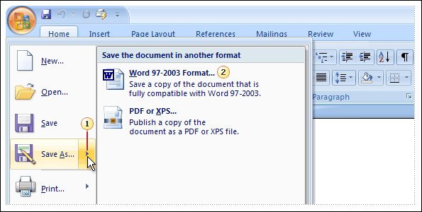
Share documents by saving with an older format
How to save a document created in the new version of Word in an older file format
If you’re concerned that John doesn’t have his installation of Office 2000 fully updated, you’ll want to save your document with an older file format before sending it to him.

Slide 98
Share documents by saving with an older format
How to save a document created in the new version of Word in an older file format
Here’s how:
Click the Microsoft Office Button, and on the menu, point to the arrow at the end of the Save As command.

Slide 99
Share documents by saving with an older format
How to save a document created in the new version of Word in an older file format
Here’s how:
Click Word 97-2003 format on the list of options.

Slide 100
Test 3, question 1
In the title bar of your Word document, it says, “Marketing report.doc (Compatibility Mode).” What does this mean? (Pick one answer.)
You can work with the document but can’t save it.
You can’t work with the document, because it’s not compatible.
You can work with the document using all the new Word features.
You can work in the document, but Word will limit some new features.

Slide 101
Test 3, question 1: Answer
You can work in the document, but Word will limit some new features.
The document is in the older file format and does not understand the new features in Word 2007. So those features are limited or disabled.

Slide 102
Test 3, question 2
Someone sent you a Word 2000 document. Can you open it in Word 2007? (Pick one answer.)
Yes, but you’ll get a warning telling you to get a converter.
Yes, but the document will open in compatibility mode.
Yes, if you first turn on compatibility mode with the Quick Access Toolbar.
No, only files from Word 2002 and later can be opened in the new version of Word.

Slide 103
Test 3, question 2: Answer
Yes, but the document will open in compatibility mode.
Also, some features will be limited because you are working with an older file format.

Slide 104
Test 3, question 3
What happens if you click the Convert command on the menu that opens from the Microsoft Office Button? (Pick one answer.)
Word upgrades the existing file to the new file format and turns on the new features available in Word 2007.
Word limits its features to be compatible with the document’s file format.
Word opens the document in a safe, read-only state so that you can view it in the new file format.

Slide 105
Test 3, question 3: Answer
Word upgrades the existing file to the new file format and turns on the new features available in Word 2007.
This is what happens when you upgrade the document file format. And if you have Windows configured to show file extensions, you’ll see that the extension changes from .doc to .docx.

Slide 106
Quick Reference Card
For a summary of the tasks covered in this course, view the Quick Reference Card (requires Word 2007, part of the 2007 Microsoft Office system, beta 2 version)

